Slide 1

Unit 01.01.02
CS 5220:
COMPUTER COMMUNICATIONS
Computer Network Evolution
XIAOBO ZHOU, Ph.D.
Professor, Department of Computer Science

Slide 2
Computer Network Evolution
1960s: Terminals access shared host computer
  SAGE; SABRE airline reservation system
  Tree-topology terminal-oriented networks
1970s: Computers connect directly to each other
  ARPANET packet switching network
  TCP/IP Internet protocols
  Ethernet local area network
1980s - 2000s: New applications and Internet growth
  Commercialization of Internet
  E-mail, file transfer, web, P2P, . . .
  Internet traffic surpasses voice traffic

Slide 3
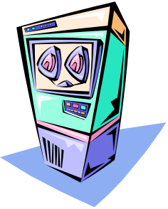
Terminal-Oriented Networks
Early computer systems very expensive; Time-sharing methods allowed multiple terminals to share local computer
Remote access via telephone modems
Terminal
. . .
Terminal
Modem
Telephone
Network
Modem
Terminal
Host computer

Slide 4
Medium Access Control
Dedicated communication lines were expensive
Terminals generated messages sporadically
Frames carried messages to/from attached terminals
Address in frame header identified terminal
Medium Access Controls for sharing a line in arbitrated manner
Example: Polling protocol on a multi-drop line
Polling frames & output frames
input frames
Terminal
Terminal
. . .
Terminal

Slide 5
Multiplexing
Multiplexer allows a line to carry frames to/from multiple terminals
Frames are buffered at multiplexer until line becomes available, i.e. store-and-forward
Header carries other control information for framing
CRC Information Header
Terminal
Terminal
Header Information CRC
. . .
Terminal
Frame
Host computer
Multiplexer

Slide 6
Error Control Protocol
Communication lines introduced errors
Error checking codes used on frames
  “Cyclic Redundancy Check” (CRC) calculated based on frame header and information payload, and appended
  Header also carries ACK/NAK control information
Retransmission requested when errors detected
CRC Information Header
Terminal
Header Information CRC

Slide 7
Computer-to-Computer Networks
As cost of computing dropped, terminal-oriented networks viewed as too inflexible and costly
Need to develop flexible computer networks
  Interconnect computers as required
  Support many applications
Application Examples
  File transfer between arbitrary computers
  Execution of a program on another computer

Slide 8
Packet Switching
Network should support multiple applications
  Transfer arbitrary message size
  Low delay for interactive applications
  Store-and-forward operation could induce high delay on interactive messages
Packet switching introduced
  Network transfers packets using store-and-forward
  Packets have maximum length
  Break long messages into multiple packets
  By switching, packets delivered (and reassembled) at destination

Slide 9
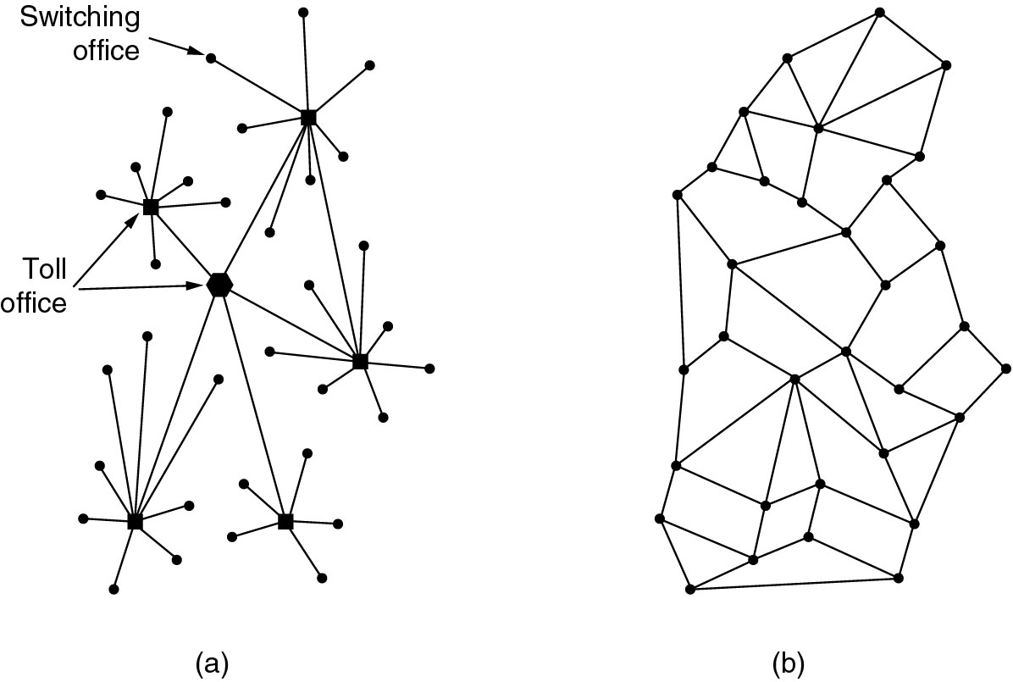
The ARPANET
The vulnerability of the telephone system was a concern.
(a) Telephone system structure; (b) Distributed switching system structure

Slide 10
The ARPANET Design
Connection-less packet transmission
Packets are encapsulated in frames
Error control uses check bits
Destinations identified by unique addresses
Routing tables at the packet switches
Messages are segmented into packets
End-to-end congestion control
Flow control prevents buffer overflow

Slide 11
ARPANET Applications
ARPANET (NSF-NET) introduced new applications
  Email, remote login, file transfer, …
AMES
McCLELLAN
UTAH
BOULDER
GWC
CASE
RADC
ILL
LINC
CARN
AMES
USC
MIT
UCSB
MITRE
STAN
SCD
ETAC
UCLA
RAND
TINKER
BBN
HARV
NBS

Slide 12
Ethernet Local Area Network
In 1980s, affordable workstations available
Need for low-cost, low error rate, high-speed network, possible using coaxial cable
Broadcasting, medium access control
Network interface card with a unique address
Ethernet is the standard for high-speed wired access to computer networks

Slide 13
Summary of the Lesson
Services and Applications drive network architecture design

